Slide 1
COP4020 – Programming Languages
Scripting Languages

Slide 2
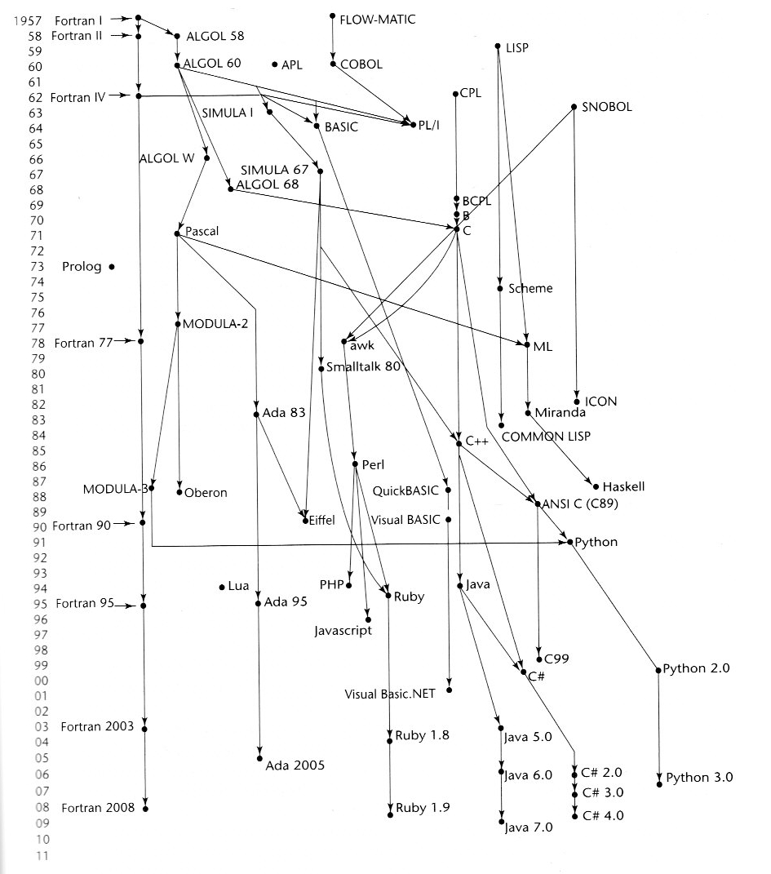
jcl

Slide 3
Introduction
Scripting languages started as programming languages to support programs written for a special run-time environment.
Originally used to automate tasks that could have been executed one-by-one by a human operator.
Scripting languages are usually interpreted.
Early scripting language primitives were elementary tasks or API calls.
As time went by scripts were combined into more complex programs.
Environments that can be automated through scripting include
Software applications
Web pages within a web browser,
Shells of operating systems
Embedded systems
Games.

Slide 4
Introduction
A scripting language can be viewed as a domain-specific language for a particular environment.
In the case of scripting an application may serve as:
extension languages – called from an application to perform a specific task
control languages – used to tie together multiple applications, possibly piping output from one to another
Scripting languages are generally designed to be high-level programming languages
The term "scripting language" is also used loosely to refer to dynamic high-level general-purpose languages, such as
Perl
Tcl
Python
sed
awk

Slide 5
Introduction
The spectrum of scripting languages:
very small and highly domain-specific languages
general-purpose programming languages used for scripting.
Some other examples:
Bash: for Unix/Linux operating systems
ECMAScript (JavaScript): primarily a scripting language for web browsers, but is also used as a general-purpose language.
Visual Basic – often used as a GUI language
Lua: a language designed and widely used as an extension language.
Python is a general-purpose language that is also commonly used as an extension language
Scripting language dialects of general-purpose languages.
  The Emacs Lisp dialect of Lisp
  Visual Basic for Applications
Some game systems languages
  Second Life virtual world
  Trainz

Slide 6
Characteristics
Any language can be used as a scripting language, but some are better suited than others:
Java:
  has a lengthy syntax and rules about which classes exist in which files
  can't be executed interactively
Python:
  can be by simply defining some functions in a file
  may avoid functions altogether (can be used interactively like Lisp and Prolog).
Scripting languages are usually interpreted directly from source code or from bytecode
The software environment the scripts are written for is typically written in a compiled language and distributed in machine code form (eg: as virtual machines).
Scripting languages are intended to be fast to learn.

Slide 7
Characteristics
Scripting languages may be designed for
use by end users of a program for end-user development
internal use by developers, so they can write portions of the application suite in the scripting language.

Slide 8
Types of Scripting languages:
Glue languages:
  connect together software components:
  Pipelines and shell scripting (wrapper programs)
  Example: interfacing between a database and a web server
Job control languages and shells
  Automate job control
  IBM's JCL
  command-line interpreters
  Unix shell
  MS-DOS command.com.
GUI scripting
  Used to put GUI front ends on non-GUI applications – often legacy systems.
  Examples: Visual Basic, Perl, Rexx
Application-specific languages
  Designed for a single application
  contains special features to support a dedicated purpose
  Can be viewed as a domain-specific
Embeddable languages
  Embedded in or run by application programs.
  Example: JavaScript began as and primarily still is a language for scripting inside web browsers

Slide 9
JCL
//IS198CPY JOB (IS198T30500),'COPY JOB',CLASS=L,MSGCLASS=X
//COPY01 EXEC PGM=IEBGENER
//SYSPRINT DD SYSOUT=*
//SYSUT1 DD DSN=OLDFILE,DISP=SHR
//SYSUT2 DD DSN=NEWFILE,
// DISP=(NEW,CATLG,DELETE),
// SPACE=(CYL,(40,5),RLSE),
// DCB=(LRECL=115,BLKSIZE=1150)
//SYSIN DD DUMMY

Slide 10
Shell Script Examples
#!/bin/bash
# declare STRING variable
STRING="Hello World"
#print variable on a screen
echo $STRING
(Linux: pl/script/s2/bash1 {use sh})
#!/bin/bash
#Define bash global variable
#This variable is global and can be used anywhere in this bash script
VAR="global variable"
function bash {
local VAR="local variable"
echo $VAR
}
echo $VAR
bash
# Note the bash global variable did not change
# "local" is bash reserved word
echo $VAR
(Linux: pl/script/s2/bash2 {use sh})
Bash Scripting Tutorial

Slide 11
Pipes and shell scripting
Part of shell scripting is being able to link multiple operations of different types together.
Operating system commands,
Utility programs
Application programs
Pipes "pipe" the output of one operation into the next operation
$ ps aux | grep ./final | grep -v grep | awk '{print $2}' | xargs kill
(Linux: pl/script/s2/pipe
reminder: start endlessloop, run run.sh from a different console)

Slide 12
GUI scripting
Perl example using the Wx module.
Provides access to the wxWidgets cross-platform GUI (Graphical User Interface) toolkit with Perl.
The toolkit supports:
  drawing buttons and other widgets on the screen
  Interactions with the user via the keyboard and mouse.
The wxWidgets toolkit runs on
  Windows
  MacOS
  Linux platforms
Creates applications which have a "native" look-and-feel on each platform. It does this by building on top of each platform's native widget toolkit.
Jump drive: perl\gui.pl
Run in cmd shell: F:\perl>run <driveletter>

Slide 13
Embedded Scripting
<html>
<head>
<title>PHP Test</title>
</head>
<body>
<?php echo '<p>Hello World</p>'; ?>
</body>
</html>
<!DOCTYPE html>
<html>
<body>
<?php
$color = "red";
echo "My car is " . $color . "<br>";
echo "My house is " . $COLOR . "<br>";
echo "My boat is " . $coLOR . "<br>";
?>
</body>
</html>

Slide 14
Client-side versus Server-side Processing
In Web-based applications, work performed is distributed between clients and servers
Javascript is a major client-side development language
  Case sensitive, has functional aspects
  Variables do not have type specifications; if a variable has not been declared before referenced, it is created
  Arithmetic, comparison, assignment and logical operators are those of C/C++/Java
  Iterators and selectors are like C/C++/Java
  Supports arrays
  Supports objects and prototyping
  Has exception handling
php is a major server-side development language:
  Open-Source scripting language evolved from Perl scripts in 1995
  PHP 5.0 was released in 2004 (object-oriented approach)
  PHP 5.0 has much better support for XML than earlier versions (supports DOM level 3)
  SAX support was available in PHP 4.0 and has not changed in PHP 5.0

Slide 15
Client-side versus Server-side Processing
Benefits of Server-side Processing
  Applications on the server transform output to XHTML and send it to the client – no need to do tests for different types of browsers
  Server-side transformations might decrease quantity of information downloaded
  Server-side processing is somewhat more secure – sensitive data can be kept on the server instead of sent to the client
Major drawback to server-side processing: more load on the server
Major Client-side processing advantages:
  offload server processing
  more efficient (partial page) updates
Major Client-side processing disadvantages
  incompatibilities among browsers
  varying support for standards (although the general trend seems to be toward greater compliance)
Server-side languages: VB.NET, Visual C# .NET, PHP, Coldfusion, Java Server Pages, Perl, etc.

Slide 16
AJAX
Short for asynchronous JavaScript and XML
a set of web development techniques using many web technologies on the client-side to create asynchronous Web applications.
Applications can send data to and retrieve from a server asynchronously (in the background) without interfering with the display and behavior of the existing page.
Decouples the data interchange layer from the presentation layer,
Allows for web pages, and web applications, to change content dynamically without the need to reload the entire page.
The use of XML is not required (JSON is often used in the AJAJ variant)
Ajax is not a technology, but a group of technologies.
JavaScript and the XMLHttpRequest object provide a method for exchanging data asynchronously between browser and server to avoid full page reloads.

Slide 17
Some examples
Javascript ajax example
Jump drive: localhost/ajax/firstajax/t1.htm
php
Jump drive: localhost/phpintro/form1.htm
XAMPP download site:
https://www.apachefriends.org/index.html

Slide 18
Python
Constants:
class _const:
class ConstError(TypeError): pass
def _ _setattr_ _(self, name, value):
if self._ _dict_ _.has_key(name):
raise self.ConstError, "Can't rebind const(%s)"%name
self._ _dict_ _[name] = value
def _ _delattr_ _(self, name):
if self._ _dict_ _.has_key(name):
raise self.ConstError, "Can't unbind const(%s)"%name
raise NameError, name
import sys
sys.modules[_ _name_ _] = _const( )
Now:
const.magic = 23
…
const.magic = 88 # would raise const.ConstError
del const.magic # would raise const.ConstError

